Slide 1
Let’s Do LinkedIn!
What LinkedIn Can Do For You and Edgio

Slide 2
What Is LinkedIn?
850 million members and growing
70% of logins are passive (done for a purpose other than looking at jobs)
The #1 thing people do on the site is look at other profiles
LinkedIn offers something called LinkedIn Premium for recruiters and hiring managers. They can use this to better source candidates.

Slide 3
Today’s Agenda
Why we want you to use LinkedIn
How to create an awesome profile
Posts and Articles
Be a Brand / Talent Ambassador

Slide 4
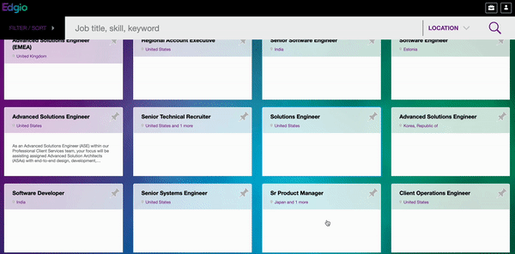
Why We Want You To Use It
Edgio currently has open positions to fill
We do have technical recruiters, but you using LinkedIn helps us reach a larger network of people who might want to work with us
We just rebranded - let’s get Edgio’s name out there!
For a remote team, LinkedIn is yet another great way to connect with your colleagues

Slide 5
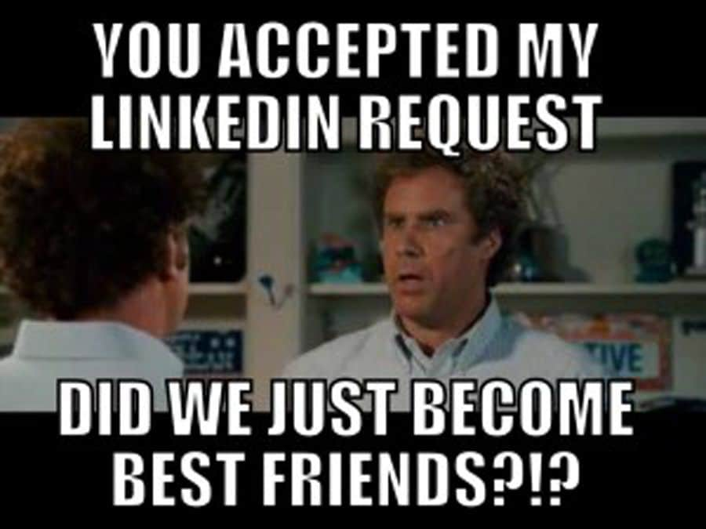
Don’t feel awkward asking your colleagues to connect!
See where they’ve been, where they’re based, and what they’re passionate about
Connecting expands all of our networks
Speaking of Colleagues…

Slide 6
What’s Wrong Here?
Let’s look at a sample LinkedIn profile
What’s missing from it?
https://www.linkedin.com/in/jane-doe-b18950251/

Slide 8
Photos
LinkedIn is like your digital resume and portfolio - it’s ok to brag
Profiles should tell a story of your professional journey
LinkedIn’s algorithm is built to increase views on profiles that have more information and use

Slide 9
Photos
You must have a photo! Members with photos have 9x more connections and 21x more views
Think about good lighting, with the image of just your face and shoulders - no other people or scenery

Slide 10
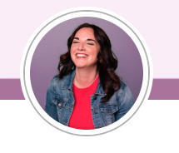
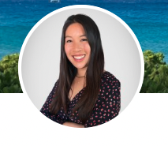
Photos
The photo should be professional but can show personality if that’s comfortable for you
Try to use an up-to-date headshot
Remember that LinkedIn puts all profile pics in round frames
Actual profile pics of LinkedIn employees

Slide 11
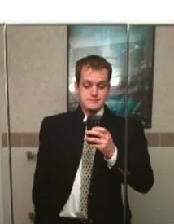

Slide 12
Too far away

Slide 13
Too far away
Not professional

Slide 14
Too far away
Not professional
Squished photo

Slide 15
Too far away
Not professional
Squished photo
Not a person

Slide 16
Too far away
Not professional
Squished photo
Not a person
Others in photo

Slide 17
Too far away
Not professional
Squished photo
Not a person
Others in photo
Bad lighting

Slide 18
Too far away
Not professional
Squished photo
Not a person
Others in photo
Bad lighting
Selfies

Slide 19
Too far away
Not professional
Squished photo
Not a person
Others in photo
Bad lighting
Selfies
Looking away

Slide 20
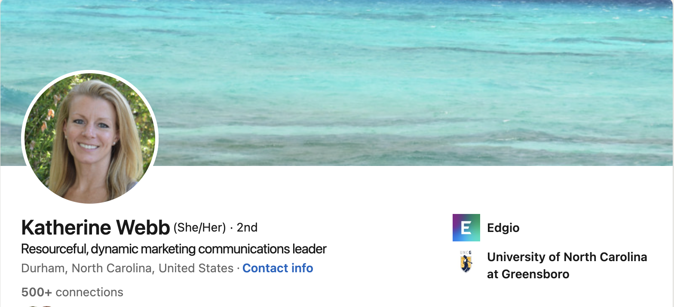
Headlines
Notes:
Lauren works at LinkedIn as one of their profile building trainers, and has an excellent example of a fully fleshed out profile.

Slide 21
Headlines
This can be your current job title at Edgio, or a short and sweet intro of your career themes (as seen here)
Headlines don’t affect the way you show up in search results
Select the little pencil at the top right of your profile header, next to your current company name
Notes:
Lauren works at LinkedIn as one of their profile building trainers, and has an excellent example of a fully fleshed out profile.

Slide 22
Did you know?
Edgio has branded images you can use for your LinkedIn profile header images.

Slide 23
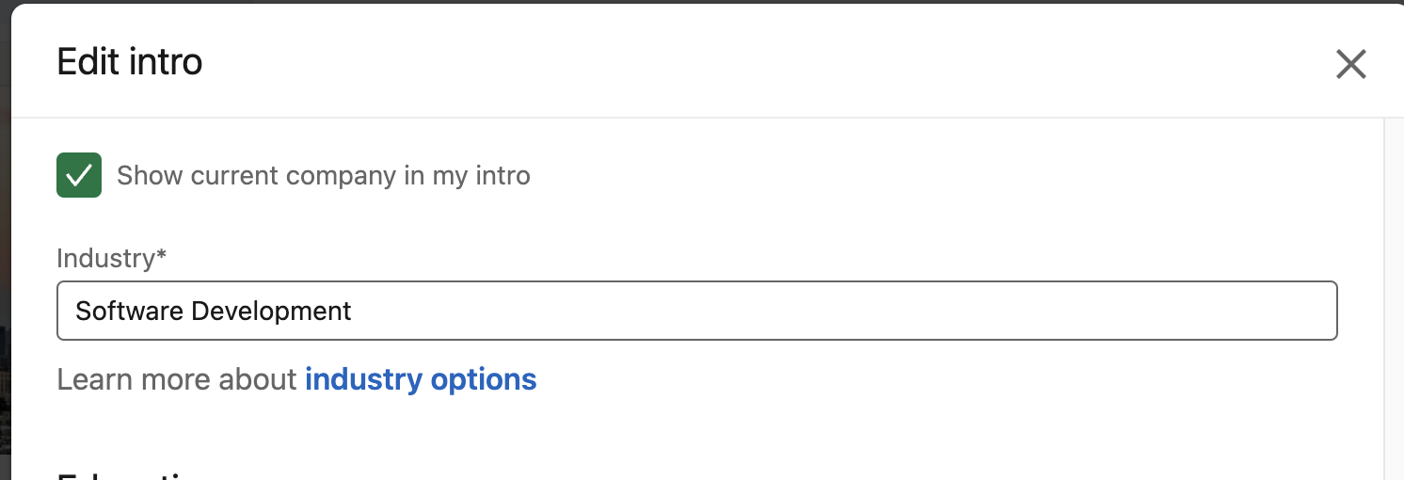
Industry
One of the most important and trickiest sections to edit
Select the little pencil at the top right of your profile header, next to your current company name
Industry is the leading way recruiters search for candidates, posts and jobs

Slide 24
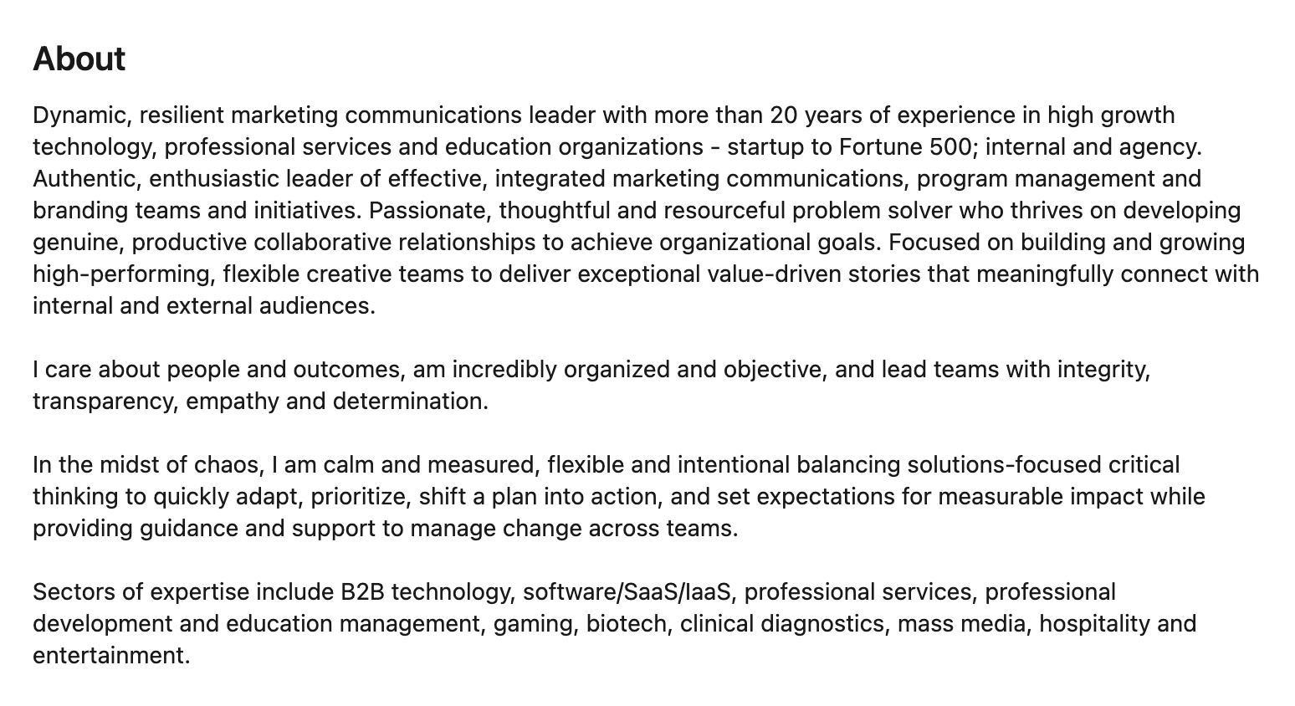
Summary (About)
Aim for 40 or more words, the length that the algorithm likes best
This is your career elevator pitch
Highlight your journey as well as your aspirations
Notes:
This should feel authentic. If you’re not bubbly or feel uncomfortable with humor, keep it friendly and direct. Read it outloud to yourself and make sure it tells a story.

Slide 25
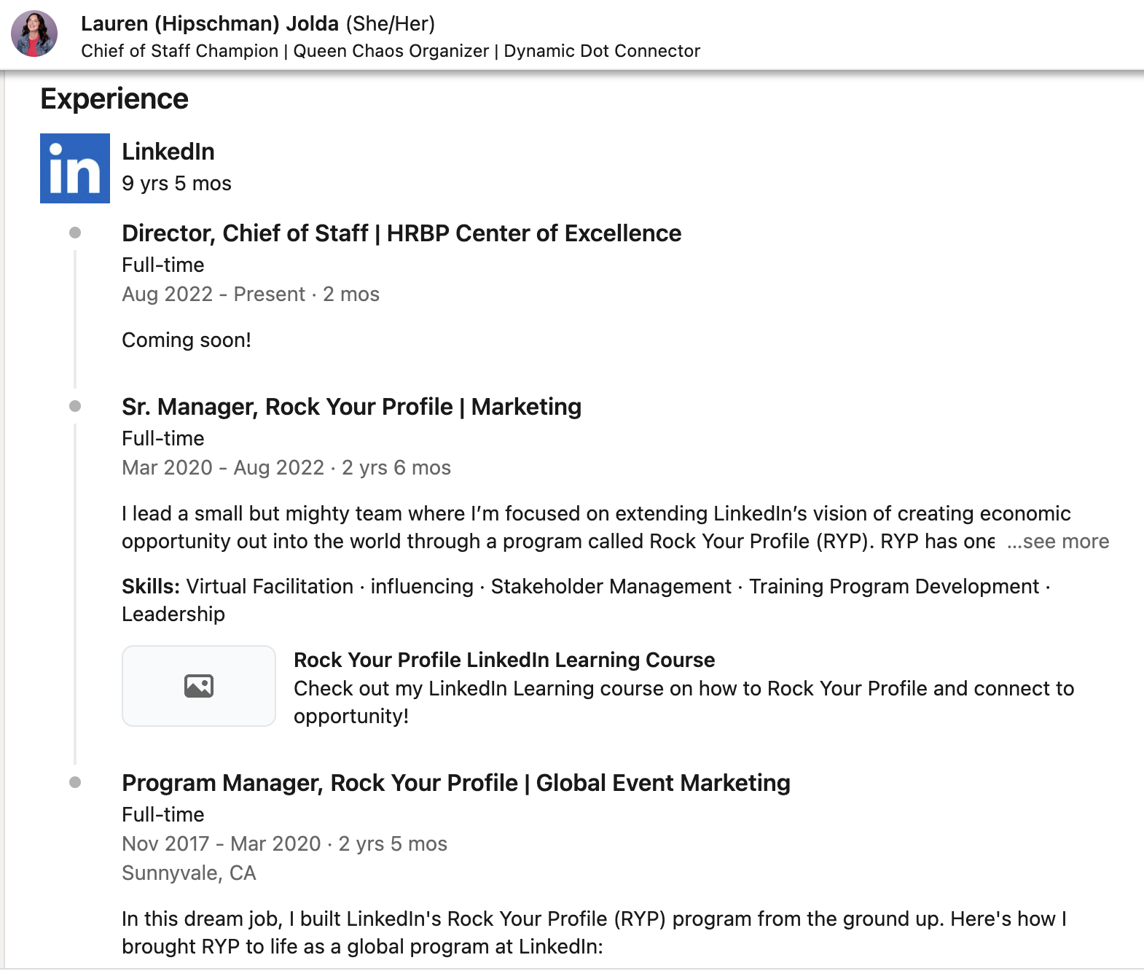
Work Experience
Current work experience gets a profile 5x more connections, 8x more views, and 10x more messages
This is like the work history part of your resume
Format can be paragraphs, bullets, whatever

Slide 26
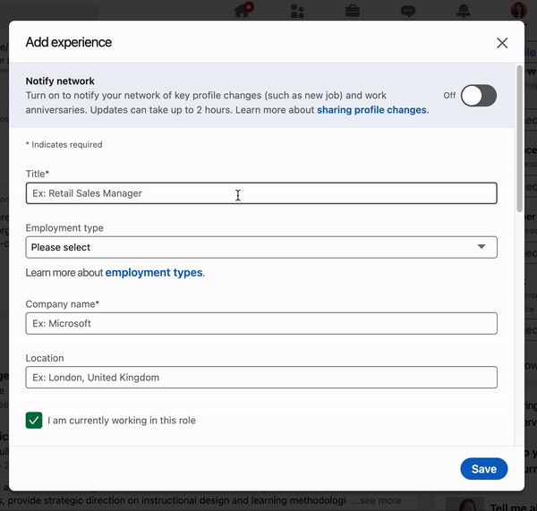
Work Experience
The goal is to tell your story and show your evolution
Add volunteer activities in the Volunteering section! These are just as important for showing skills and interests
For Edgio especially, search for the actual company and make sure it’s linked to your work experience

Slide 27
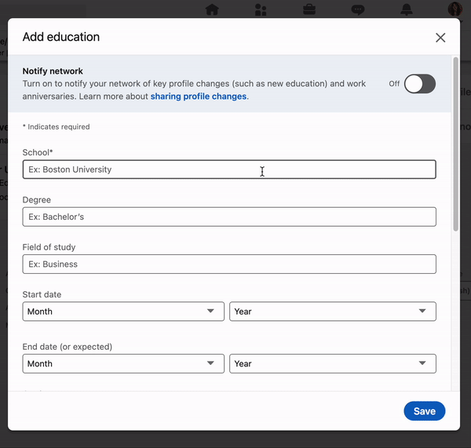
Education
This is very flexible - if you want to add your graduation year, do, but you can also skip it
As you did for Edgio, remember to select your school
This will drive other alumni to your page and our company

Slide 28
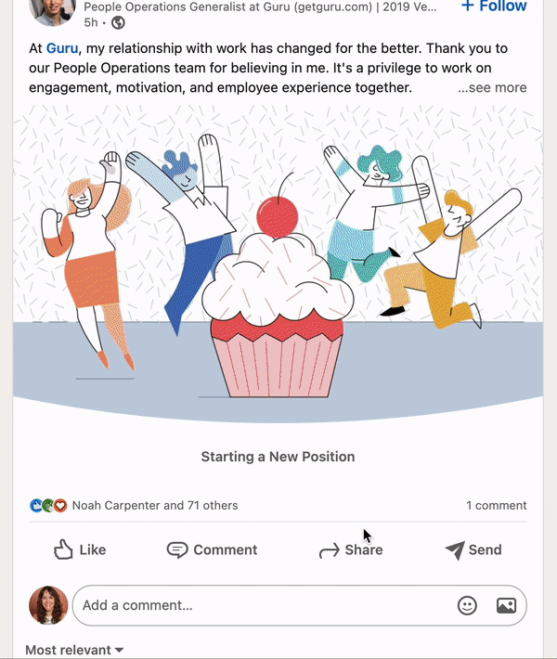
Posts and Updates
Post - deep thoughts on a topic, like a blog post
Updates - sharing links, articles, images, anything else that’s lighter length
Other users can like and comment on both
More comments on posts and updates means appearing more in other users’ feeds
Feeds contain all the posts of the people and companies you connect with… even Edgio

Slide 29
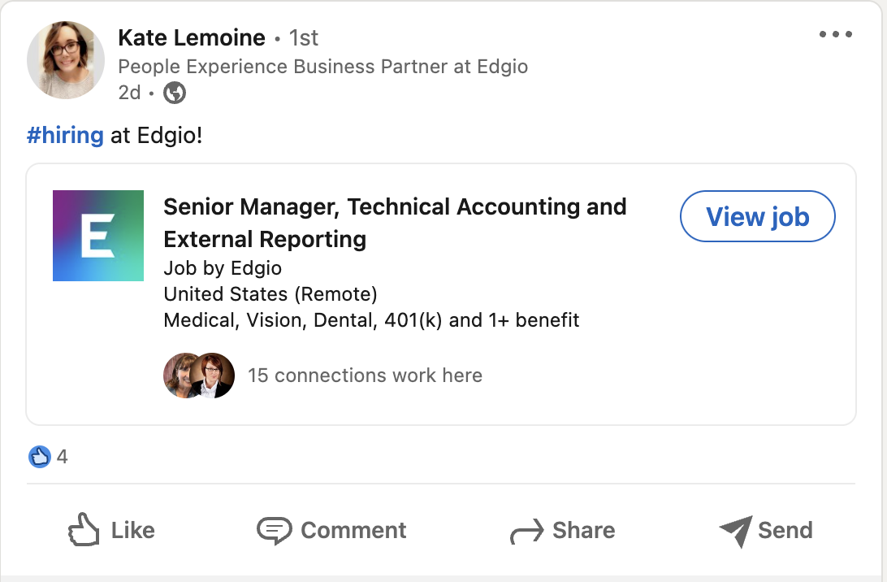
Posts and Updates
Posts are how you’ll share the jobs Edgio has open
If you’re not comfortable writing your own posts about open positions, you can just reshare job posts from your PX business partner or our recruiters

Slide 30
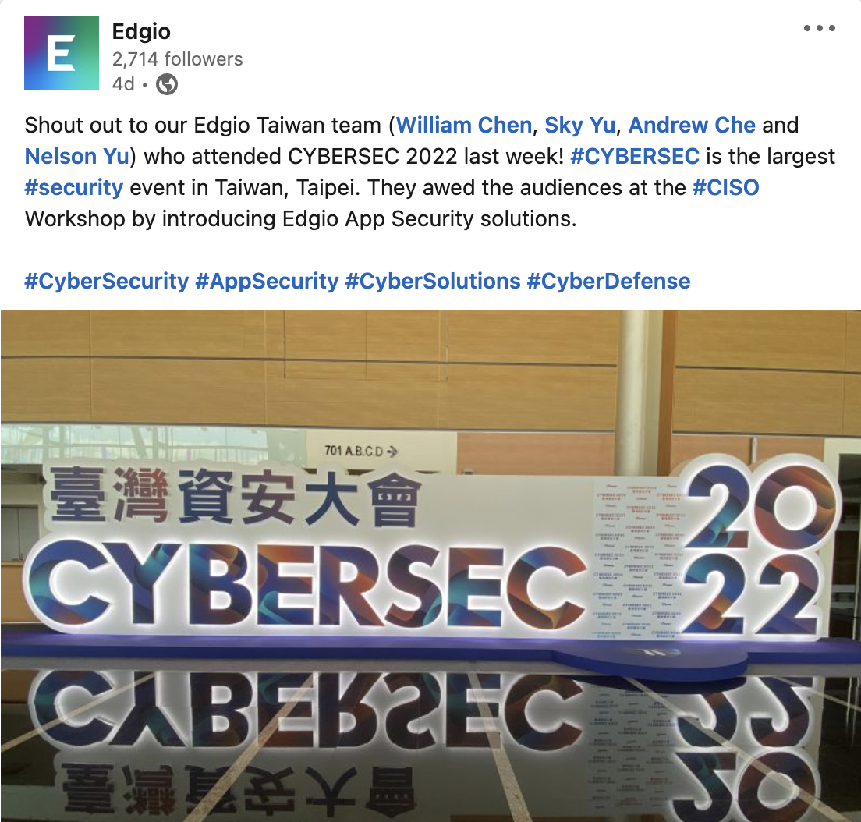
Posts and Updates
Tagging people in your posts is a great way build the network
Don’t forget to also tag Edgio as the company entity in posts for things like trade shows, cultural events, and technology news
Some of our campaigns may also have special hashtags - be sure to use those as instructed

Slide 31
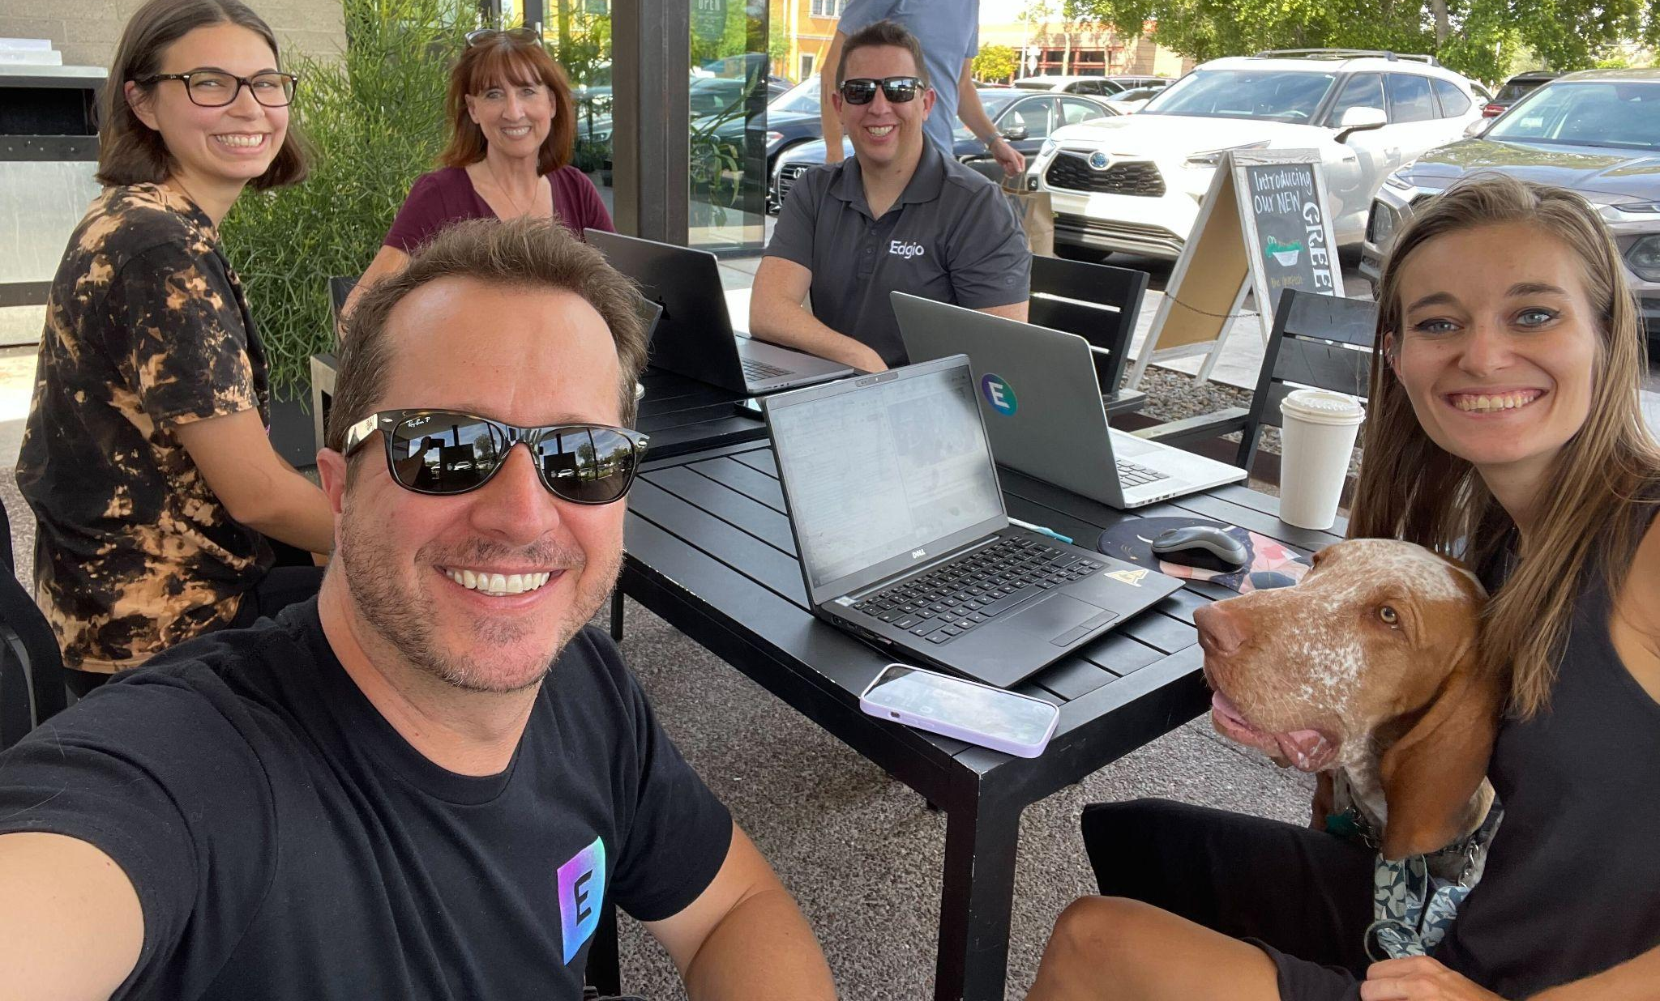
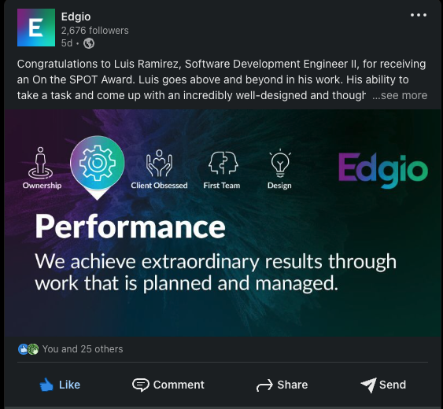
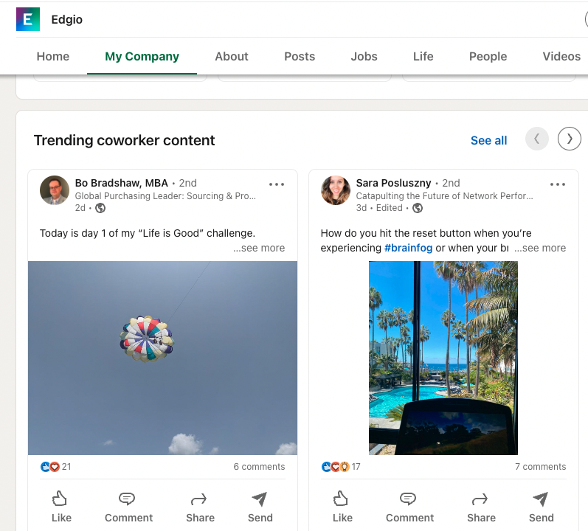
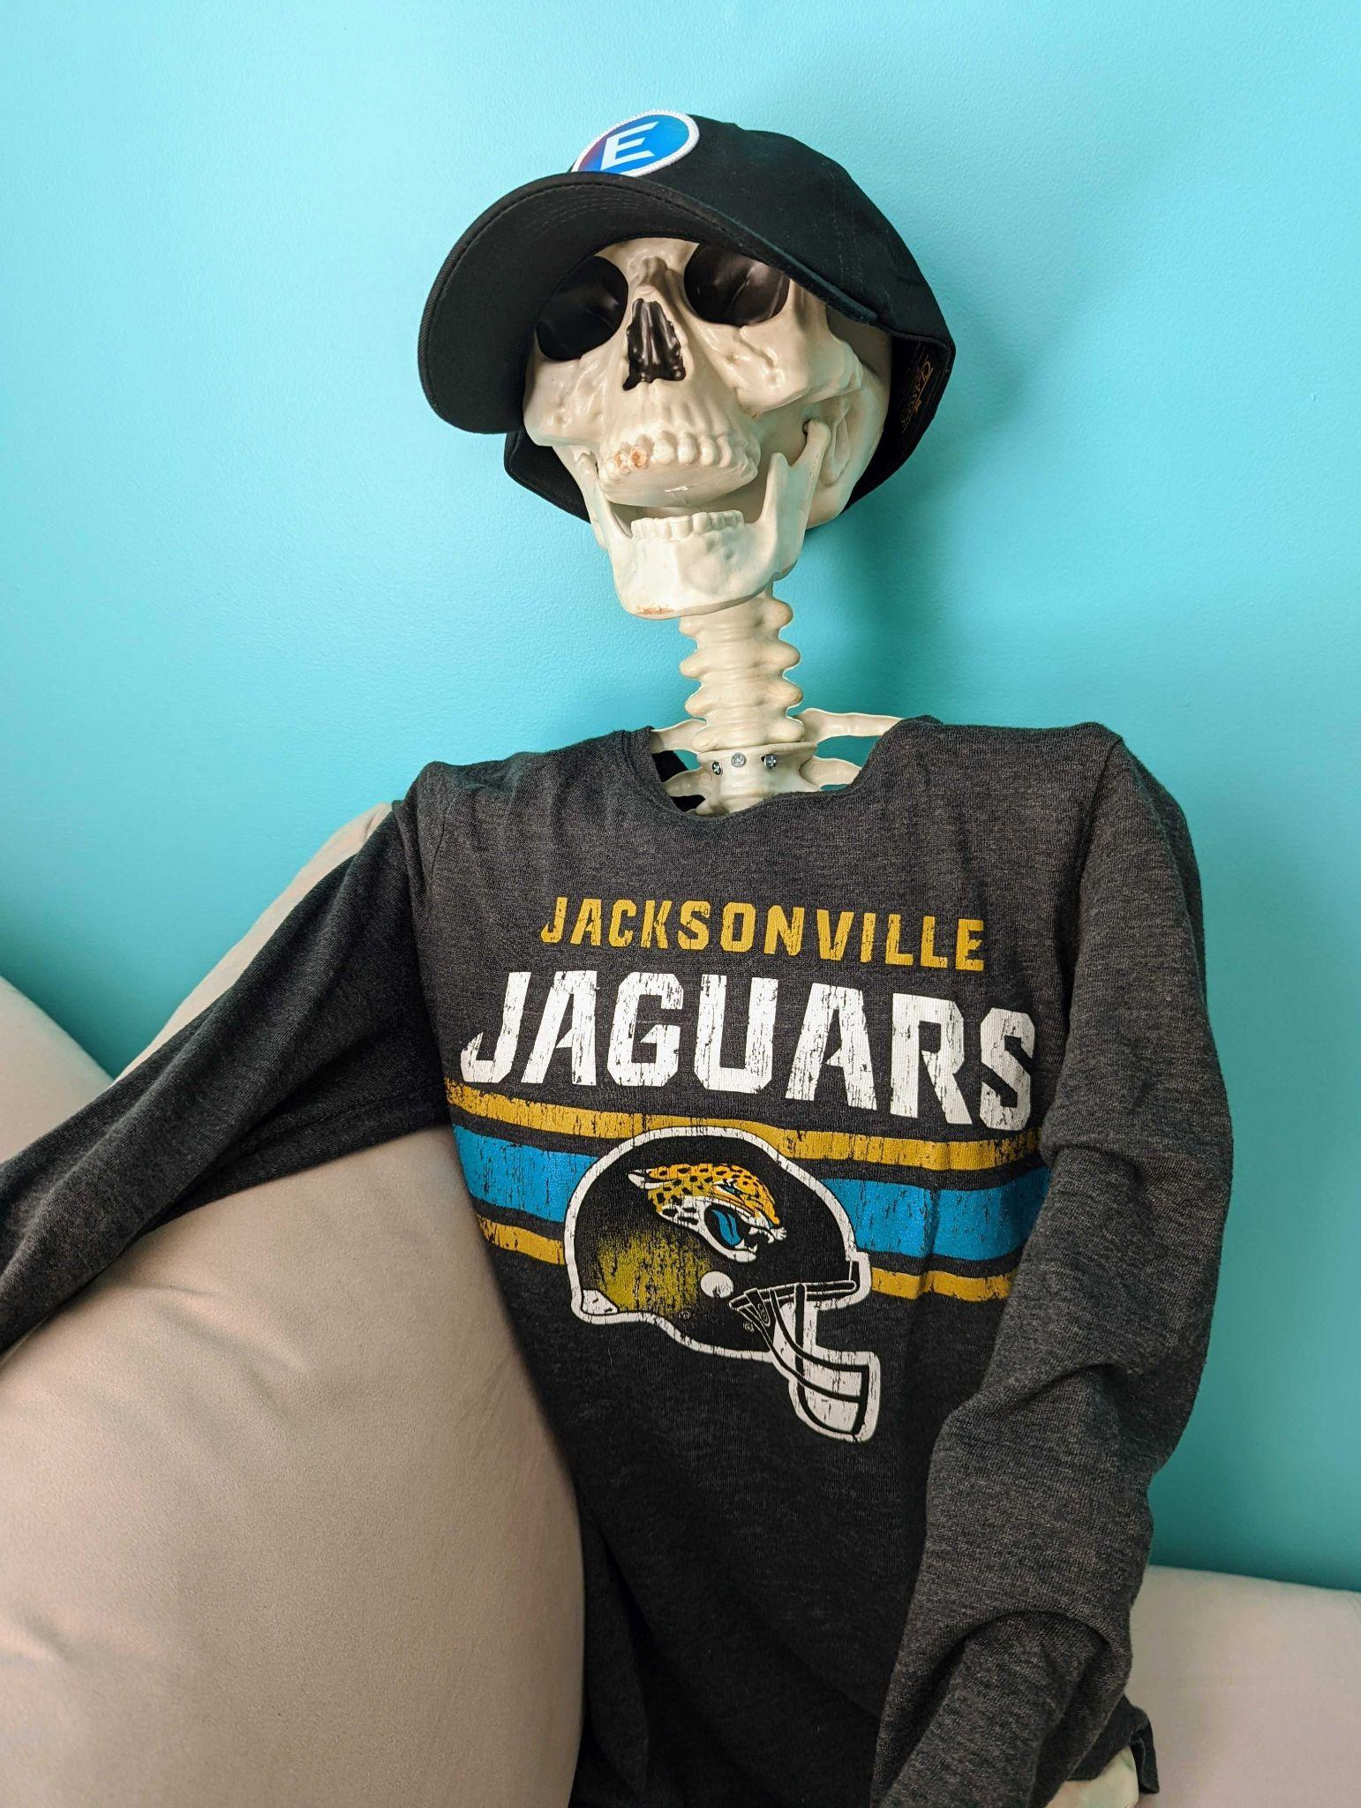
What’s a Brand / Talent Ambassador?
By sharing everything that’s great about Edgio with your LinkedIn network, you’re an ambassador for all that good stuff and for Edgio
People who might not otherwise know about us or think to look at our jobs see your activity and check us out
Show outsiders what’s satisfying and fun about working here
Your posts show up as Trending coworker content on our company page

Slide 32
What You Can Share Now
We’ll soon have a central location where you can regularly check for updates to share with your LinkedIn network. Until then, here are a few recent examples:
Core Values Campaign:
https://www.linkedin.com/feed/update/urn:li:activity:6979097305337450496 https://www.linkedin.com/feed/update/urn:li:activity:6974039235125198849
Earnings/Company News & Announcements/Positive Mentions in News/Industry:
https://www.linkedin.com/feed/update/urn:li:activity:6962543013000552448 https://www.linkedin.com/feed/update/urn:li:activity:6956279248026222592

Slide 33
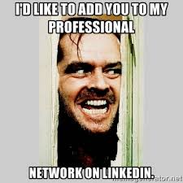
It’s OK to Say No or Ignore
A possible side effect of you becoming more active on LinkedIn is unwanted attention from others who are also trying to grow business
You do not have to accept the connection request of everyone who asks - if they look like they’re selling you something, feel free to ignore it

Slide 34
To Sum Up
Help us source great talent by:
Uploading a profile pic
Changing your profile header to Edgio brand
Adding your Edgio position to your work history
Sharing open roles and other company news from Edgio leaders and the PX team

Slide 35
QUESTIONS?

